Slide 1
Computer
Networks
- Prof. Ishani Saha

Slide 2
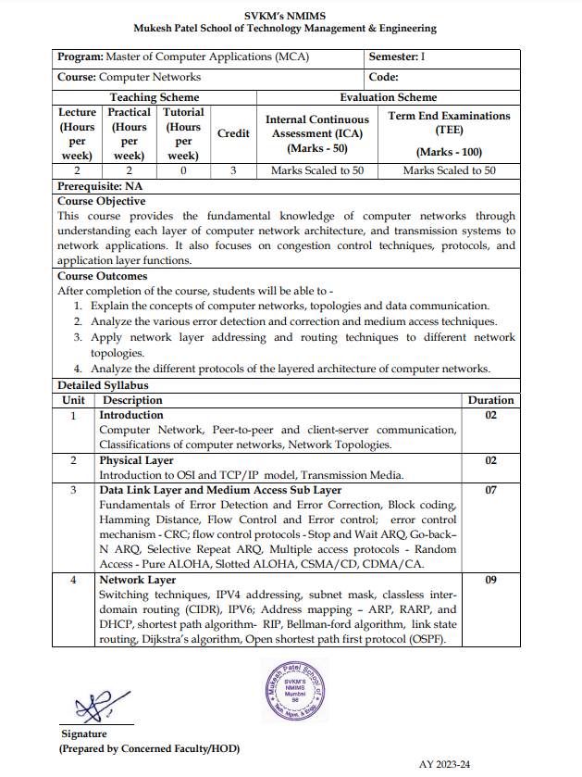
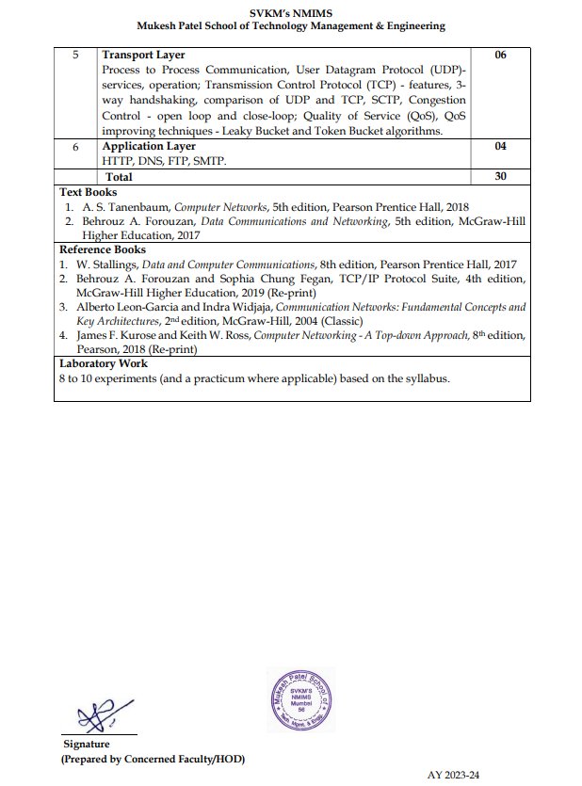

Slide 3
Chapter 1
Introduction

Slide 4
1-1 DATA COMMUNICATIONS
The term telecommunication means communication at a distance. The word data refers to information presented in whatever form is agreed upon by the parties creating and using the data. Data communications are the exchange of data between two devices via some form of transmission medium such as a wire cable.

Slide 5
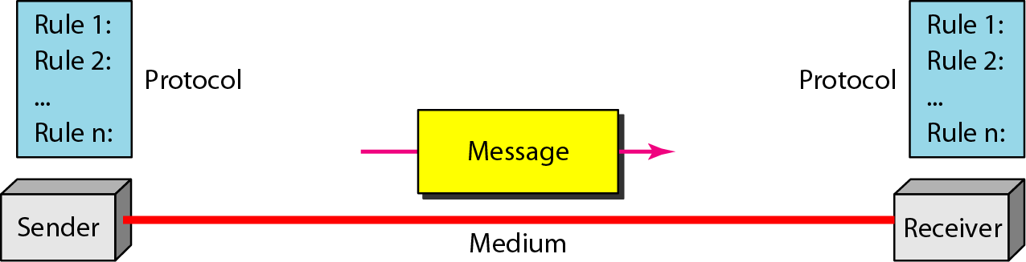
Figure 1.1 Five components of data communication

Slide 6
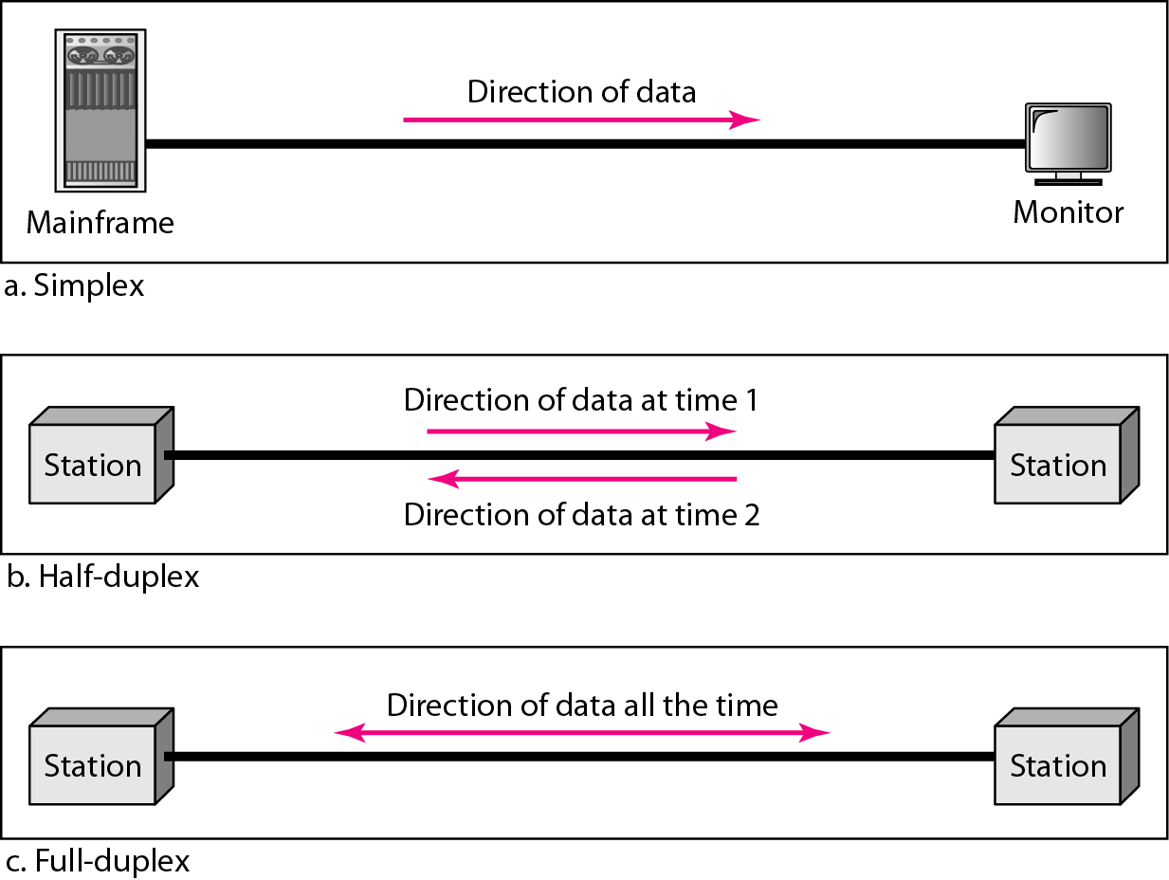
Figure 1.2 Data flow (simplex, half-duplex, and full-duplex)

Slide 7
1-2 NETWORKS
A network is a set of devices (often referred to as nodes) connected by communication links. A node can be a computer, printer, or any other device capable of sending and/or receiving data generated by other nodes on the network.

Slide 8
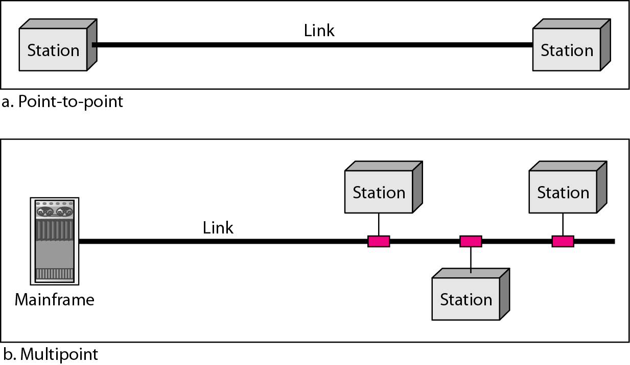
Figure 1.3 Types of connections: point-to-point and multipoint

Slide 9
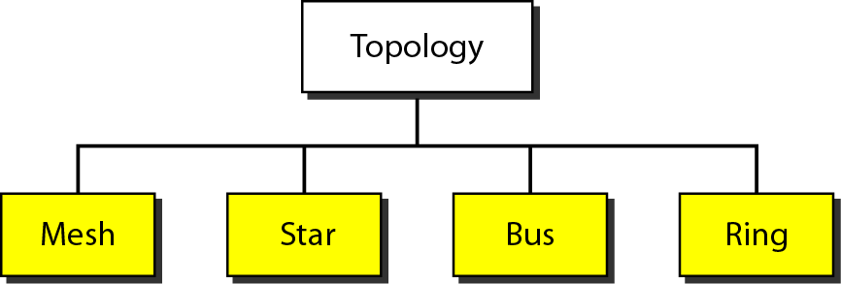
Figure 1.4 Categories of topology

Slide 10
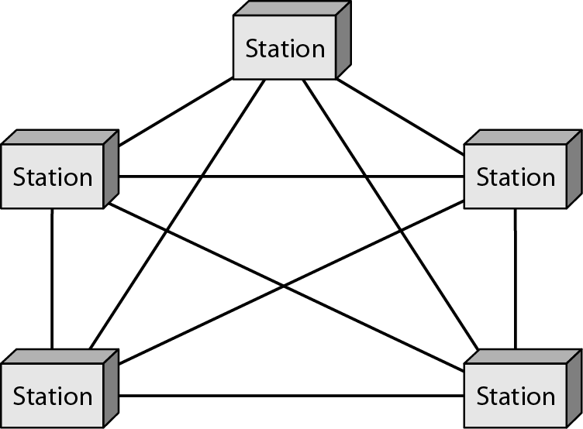
Figure 1.5 A fully connected mesh topology (five devices)

Slide 11
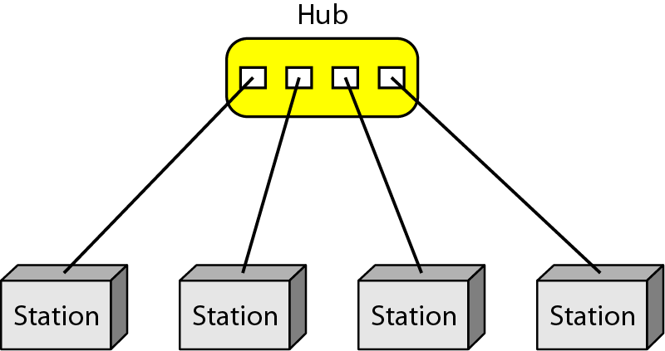
Figure 1.6 A star topology connecting four stations

Slide 12
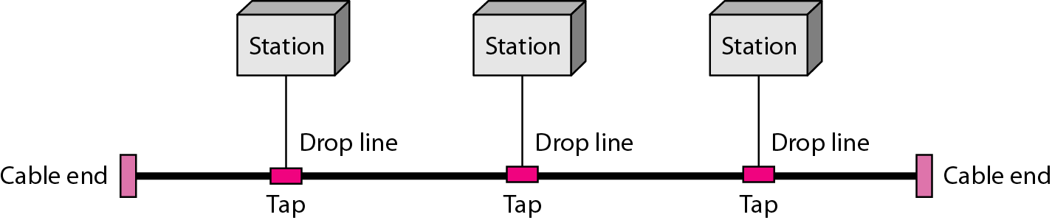
Figure 1.7 A bus topology connecting three stations

Slide 13
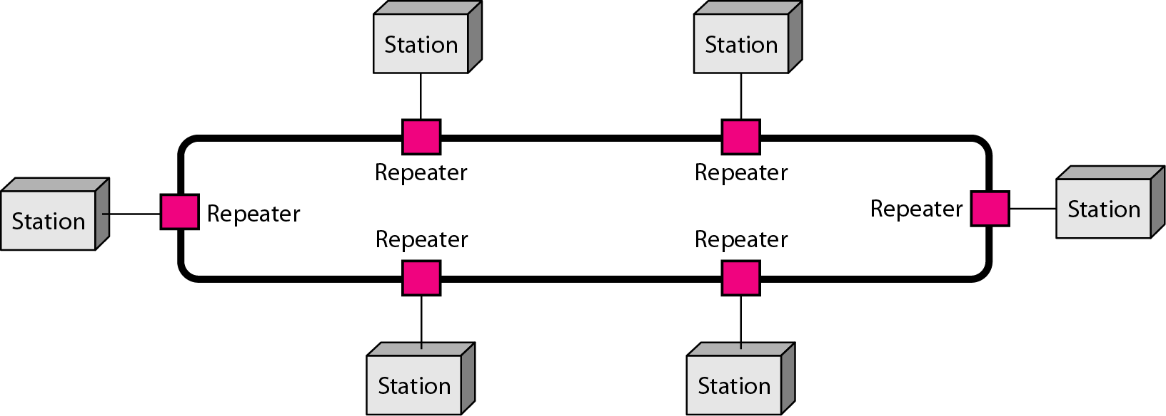
Figure 1.8 A ring topology connecting six stations

Slide 14
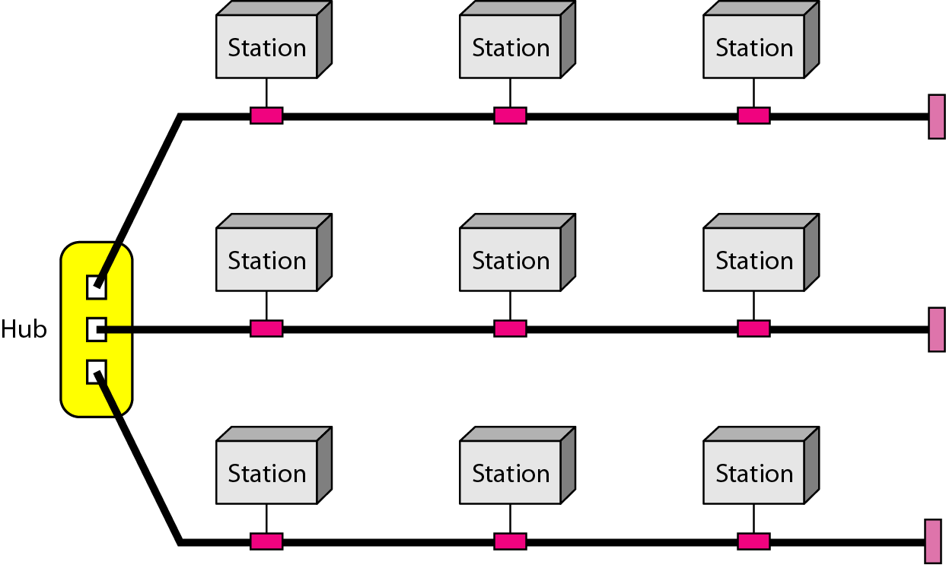
Figure 1.9 A hybrid topology: a star backbone with three bus networks

Slide 15
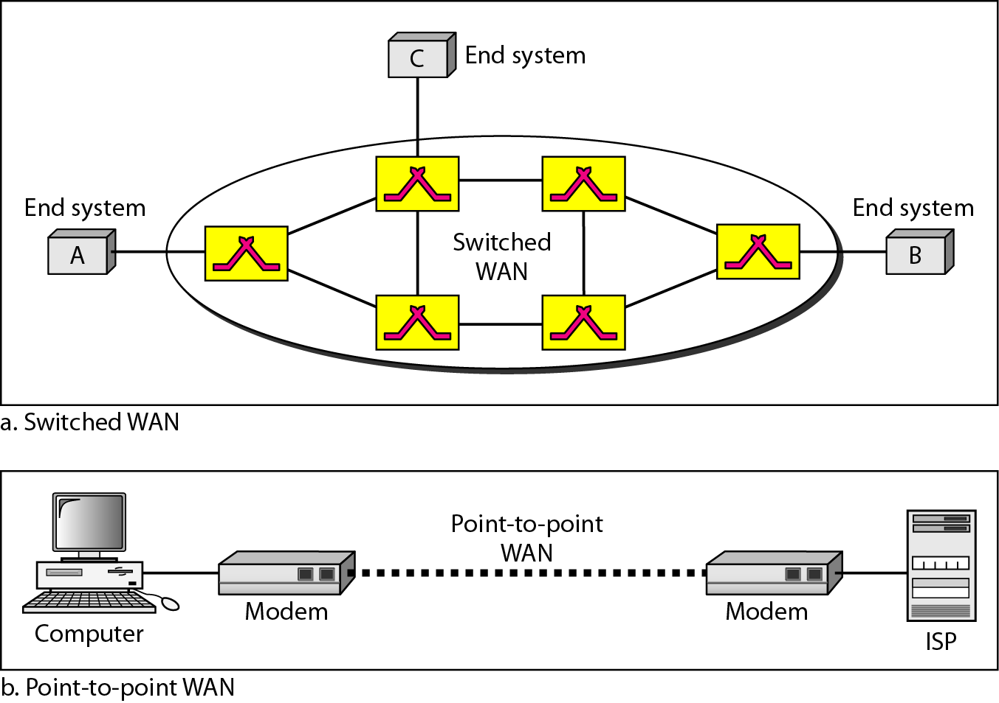
Figure 1.11 WANs: a switched WAN and a point-to-point WAN

Slide 16
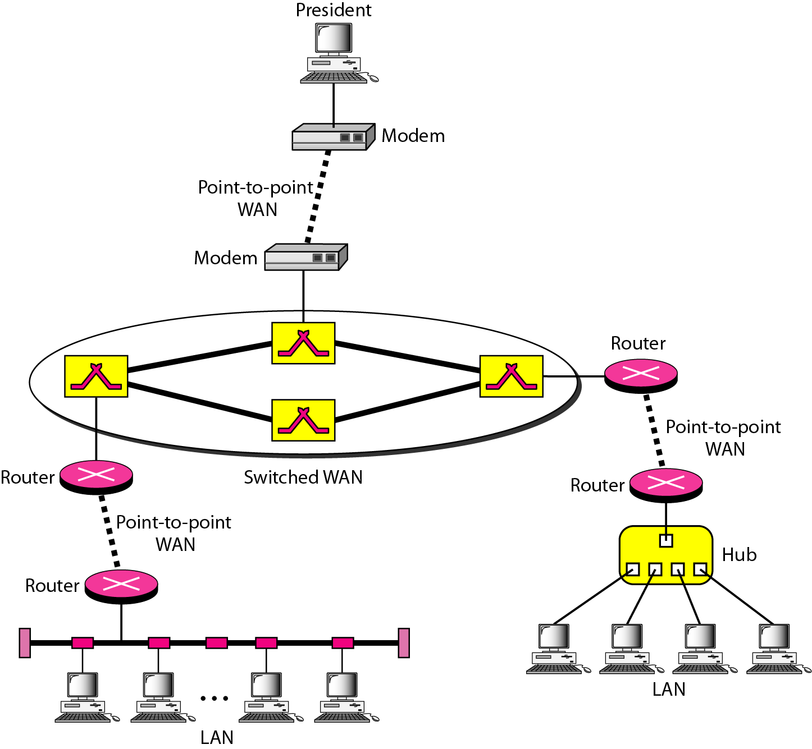
Figure 1.12 A heterogeneous network made of four WANs and two LANs

Slide 17
HOW INTERNET WORKS ?????

